Slide 1
Tuples and Sets

Slide 2
Data Structures
A list is a type of data structure.
In Python, and programming in general, there are many different types of data structures. Typically, data structures are collections, and also iterables - you can iterate through each item of them. They are a way to store multiple values in one place.
There are many different types of data structures. In Python, the main collections are lists, tuples, sets, and dictionaries.

Slide 3
Tuples
A tuple is a collection that is ordered and unchangeable.
It's similar to a list, but you can't add or remove items, and round brackets are used instead of square brackets: ( )
Tuples are faster than lists, and used to store constants - data that will not be changed. If you know you won't be changing the value of a collection, use a tuple.
Tuples can also be used as dictionary keys, or used to return multiple values from a function.

Slide 4
Using Tuples
Tuple Methods:
count() Returns the number of times a specified value occurs in a tuple
index() Searches the tuple for a specified value and returns the position of where it was found.
You can index tuples with square brackets to access items, just like a list.
my_tuple = (54, 12) -> my_tuple[0] is 54
You can loop through tuples using a for loop.
You can add two tuples together using the + operator.
tuple1 = ("a", "b", "c")
tuple2 = ("d", "e") -> tuple3 is ("a", "b", "c", "d", "e")
tuple3 = tuple1 + tuple2

Slide 5
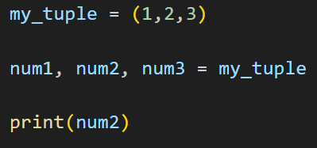
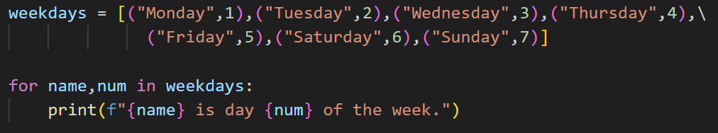
Tuple Unpacking
A tuple can be unpacked into multiple variables. You must have a variable for each item in the tuple.
The main way this is used is in for loops. If you have a list of tuples, you can go through the elements in each of the tuples efficiently using tuple unpacking.
What is the output of this code?
What is the output of this code?

Slide 6
Exercise - Tuples
You have a tuple of numbers:
numbers = (1,2,3,4,5,6,7,8,9,10,11,12)
You have a tuple of months:
months = ("January","February","March","April","May","June", "July","August","September","October","November","December")
Use these tuples to make a list of tuples where each tuple contains a number and the month it corresponds to, like this: [("January",1),...,("December",12)]
Now print each month and its number using tuple unpacking in a for loop. The first line of output should look like this:
January is month 1 of the year.

Slide 7
Set
A set is a collection that is unordered, unchangeable*, and unindexed.
* The items are unchangeable, but you can add and remove items.
Sets do not allow duplicates, so they are used to store a set of unique values. You use curly brackets for sets: { }
Because sets are unordered, you can't index them like a list. They don't have indexes at all. You can still loop through a set with a for loop.

Slide 8
Set Methods
add() Add an item to a set, like appending to a list
clear() Remove all the items in a set
copy() Returns a copy of a set
difference() Get the difference between two sets
intersection() Get the intersection between two sets (A set of items that appear in both)
isdisjoint() Returns whether two sets have an intersection or not
remove() Removes the specified element from the set
symmetric_difference() Get the symmetric difference between two sets
union() Get the union of two sets (A set of items that appear in either or both)
https://www.w3schools.com/python/python_ref_set.asp

Slide 9
Set Operations
Sets have some methods similar to lists like add() and remove(), but they also have some special methods specific to sets.
Union, intersection, difference, and symmetric difference are all logical operations that can be applied to sets. They are part of a field of math called set theory.
Each of these operations is applied to two or more sets.
Let's say setA = {0,1,2,3} and setB = {2,3,4,5}
Union: The union of set A and set B is all the items that appear in either set A or set B. Can also be represented by the | operator.
setA.union(setB) is the same as writing setA | setB.
The result is a new set: {0,1,2,3,4,5}

Slide 10
Set Operations, continued
Let's say setA = {0,1,2,3} and setB = {2,3,4,5}
Intersection: All the items that appear in both set A and set B. Shortcut: &
setA.intersection(setB) is the same as writing setA & setB.
The result is a new set: {2,3}
Difference: The items that appear in set A, but not set B. Shortcut: -
setA.difference(setB) is the same as writing setA - setB
The result is a new set: {0,1}
Symmetric difference: The items that appear in set A or set B, but not both. Can be thought of as the opposite of intersection. Shortcut: ^
setA.symmetric_difference(setB) is the same as writing setA ^ setB
The result is a new set: {0,1,4,5}

Slide 11
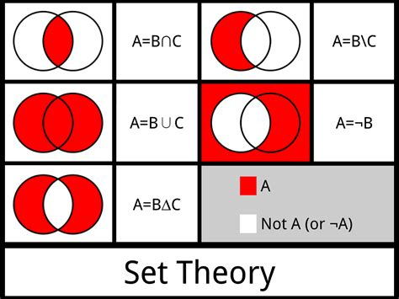
Set Operations in Set Theory
Intersection (B&C)
Difference (B-C)
Negation - Not possible with Python sets
Union (B|C)
Symmetric Difference (B^C)

Slide 12
Exercise - Sets
You work for a sales company and must generate a set of all customers who get a certain discount. The criteria for getting a discount is that they're over 60 years old and have made at least 5 purchases.
You have a set of customers over 60, and a set of customers who have made at least 5 purchases. Use a set operation to output a set of customers that fit both criteria for the discount. You can do this in one line of code.
Example:
over_60_years = {'Dominic', 'Linda', 'Simone', 'Swathi', 'Olaf'}
over_5_purchases = {'Finn', 'Simone', 'Aaron', 'Dominic'}
Output: {'Dominic', 'Simone'}

Slide 13
Exercise - Sets
You work at a company where some people know Python, some people know JavaScript, and some people know both.
In a loop, prompt the user to input an employee name, whether they know Python, and whether they know JavaScript. Use this to build two sets: a set of employees that know Python, and a set of employees that know JavaScript.
Use set operators to compute the following sets:
The set of employees that know both Python and JavaScript
The set of employees that know JavaScript, but not Python
The set of employees that know Python or JavaScript, but not both

Slide 14
Lists vs. Tuples vs. Sets
Type | Brackets | Order | Immutable/ Mutable | Allow Duplicates?
List | [ ] | Ordered | Mutable | Yes
Tuple | ( ) | Ordered | Immutable | Yes
Set | { } | Unordered | Immutable items, but you can add/remove items | No

Slide 15
Discussion: When would you choose to use a list, tuple, or set?

Slide 16
Resources
Tuples: https://www.w3schools.com/python/python_tuples.asp
Sets: https://www.w3schools.com/python/python_sets.asp
Shortcut operators for sets: https://www.geeksforgeeks.org/python-set-operations-union-intersection-difference-symmetric-difference/#

